Slide 1
Mission to Seafarers Geraldton
To change the photo, click it and delete it. Then click the placeholder icon in the centre and choose a replacement.
Information for local businesses involved in the shipping industry
2023

Slide 2
Agenda
Centre overview and history
Seafarer services and demand
Operating costs
Funding proposal

Slide 3
Centre overview and history
About the Mission to Seafarers

Slide 4
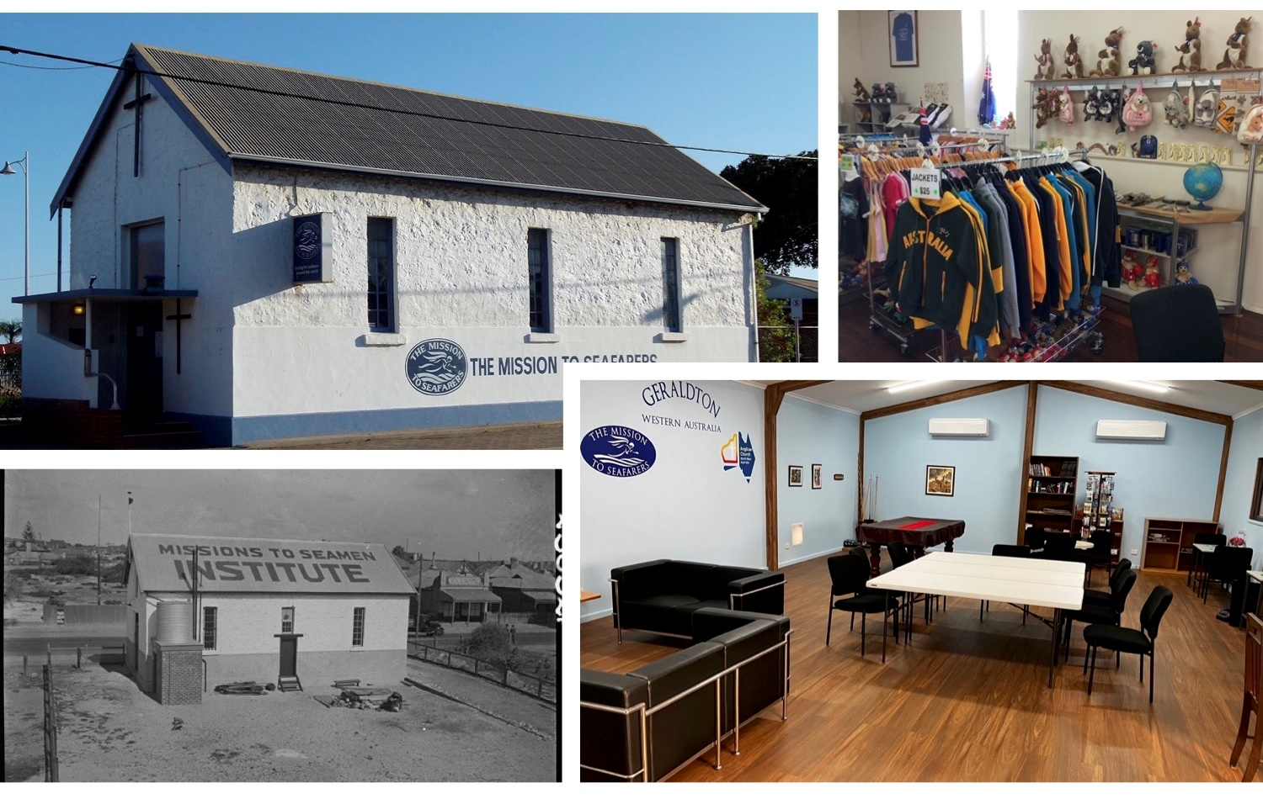
Notes:
The Mid West region contributes an annual economic output $16 billion.
389 vessels arrivals (approx. 320 unique vessels) to the Port of Geraldton in 2022FY.
The Port Maximisation Project aims to achieve an increased throughput of around 25 Mtpa by 2026, representing a 52% increase on 2022FY.
We can expect over 486 vessels per year by 2026, and more when Oakajee comes online.
Seafarers’ demand for counselling and medical services is rising. The mental health impact from extended periods on ships and the restrictions on disembarkation has been significant. The prevalence of depression, anxiety, and general psychiatric disorders among seafarers since COVID has increased.
As a signatory to the Maritime Labour Convention, Australian ports have an obligation to provide on-shore welfare services to seafarers.

Slide 5
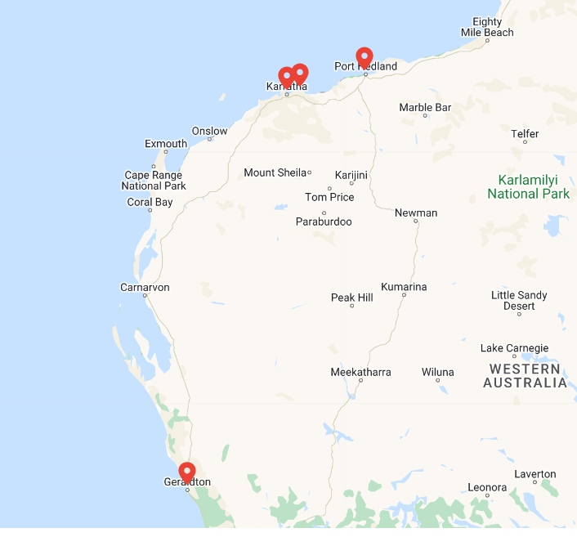
Links with Dampier/Port Walcott (and Port Hedland) centres
Governed by the Missions to Seafarers North West Australia Ltd (MTS NWA), an ACNC reg charity
MTS NWA is a not-for-profit public company limited by guarantee
We care for seafarers and crew of all ranks, nationalities and beliefs.
Notes:
The Mid West region contributes an annual economic output $16 billion.
389 vessels arrivals (approx. 320 unique vessels) to the Port of Geraldton in 2022FY.
The Port Maximisation Project aims to achieve an increased throughput of around 25 Mtpa by 2026, representing a 52% increase on 2022FY.
We can expect over 486 vessels per year by 2026, and more when Oakajee comes online.
Seafarers’ demand for counselling and medical services is rising. The mental health impact from extended periods on ships and the restrictions on disembarkation has been significant. The prevalence of depression, anxiety, and general psychiatric disorders among seafarers since COVID has increased.
As a signatory to the Maritime Labour Convention, Australian ports have an obligation to provide on-shore welfare services to seafarers.

Slide 6
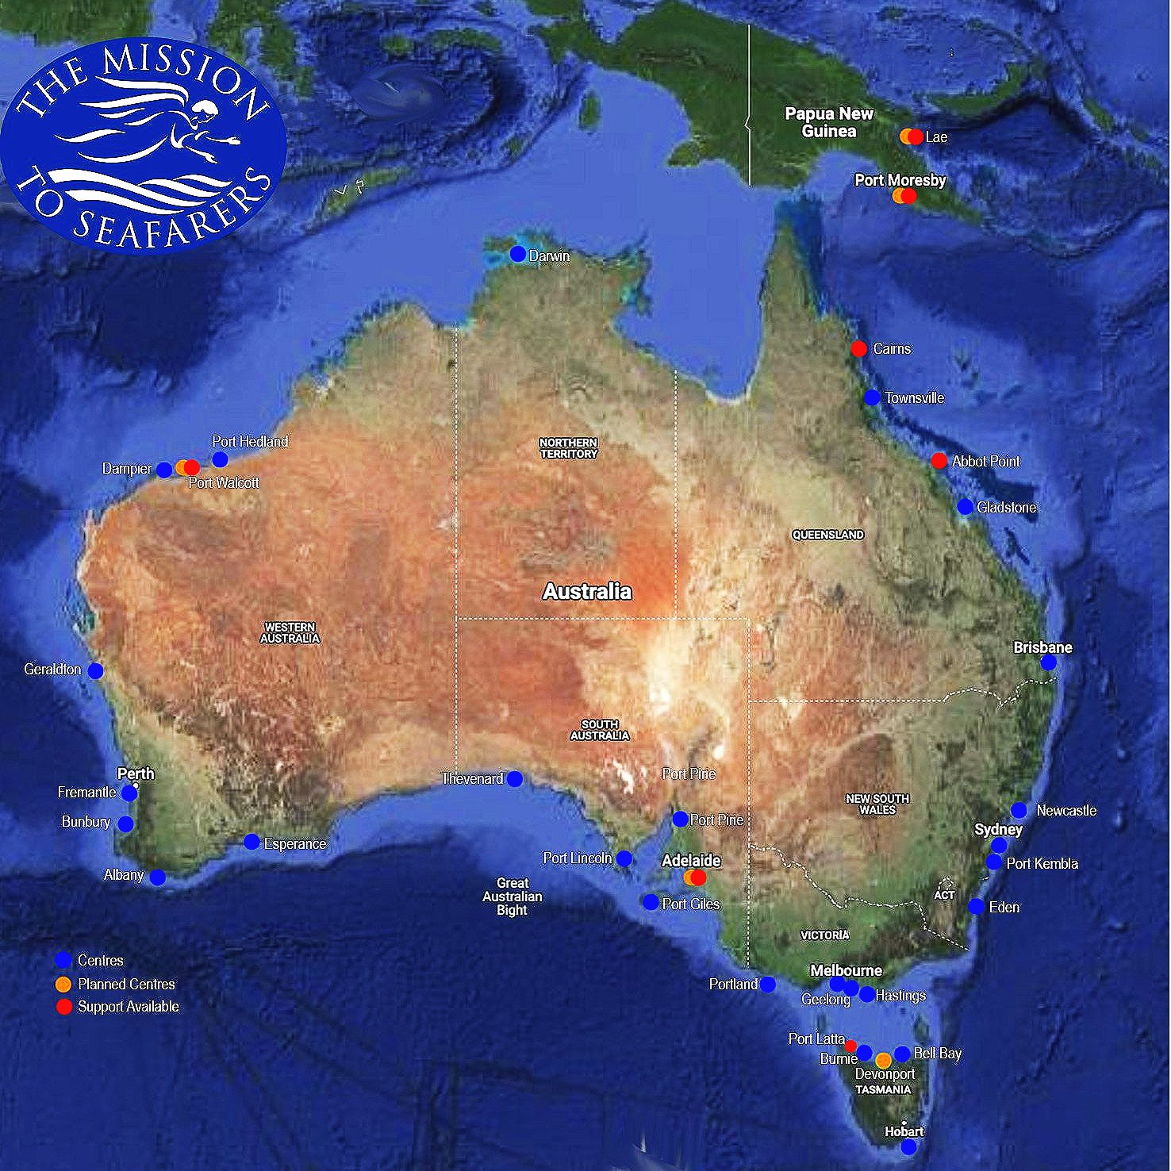
MTS Nationally & Internationally
26 centres around Australia
200 ports around the world
Services in 50 countries
Notes:
The Mid West region contributes an annual economic output $16 billion.
389 vessels arrivals (approx. 320 unique vessels) to the Port of Geraldton in 2022FY.
The Port Maximisation Project aims to achieve an increased throughput of around 25 Mtpa by 2026, representing a 52% increase on 2022FY.
We can expect over 486 vessels per year by 2026, and more when Oakajee comes online.
Seafarers’ demand for counselling and medical services is rising. The mental health impact from extended periods on ships and the restrictions on disembarkation has been significant. The prevalence of depression, anxiety, and general psychiatric disorders among seafarers since COVID has increased.
As a signatory to the Maritime Labour Convention, Australian ports have an obligation to provide on-shore welfare services to seafarers.

Slide 7
Centre Services
Ship visits, shore leave, welfare support, transport & shopping

Slide 8
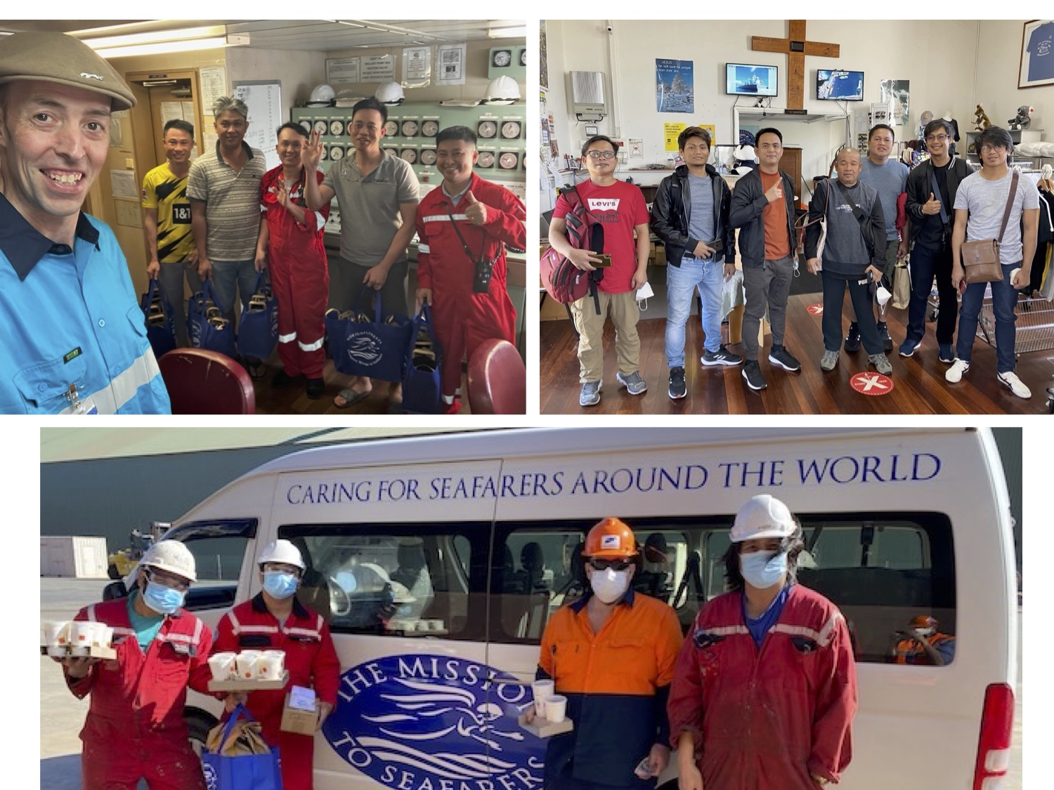
Ship visits
Shore leave
Crew support
Notes:
The Mid West region contributes an annual economic output $16 billion.
389 vessels arrivals (approx. 320 unique vessels) to the Port of Geraldton in 2022FY.
The Port Maximisation Project aims to achieve an increased throughput of around 25 Mtpa by 2026, representing a 52% increase on 2022FY.
We can expect over 486 vessels per year by 2026, and more when Oakajee comes online.
Seafarers’ demand for counselling and medical services is rising. The mental health impact from extended periods on ships and the restrictions on disembarkation has been significant. The prevalence of depression, anxiety, and general psychiatric disorders among seafarers since COVID has increased.
As a signatory to the Maritime Labour Convention, Australian ports have an obligation to provide on-shore welfare services to seafarers.

Slide 9
The demand for seafarer welfare services
389 vessel arrivals in 2022FY, ~486 vessels per year by 2026 (PMaxP)
Seafarers’ demand for counselling and medical services is rising.
Long periods away from home
Shore leave restrictions at international ports
Increasing workloads and rapid turn around times affecting work/life balance
Maritime Labour Convention: obligation for ports and industry to provide shore based welfare services to seafarers.
Each Member shall ensure that shore-based welfare facilities, where they exist, are easily accessible. The Member shall also promote the development of welfare facilities, such as those listed in the Code, in designated ports to provide Seafarers on ships that are in its ports with access to adequate welfare facilities and services.
MLC REGULATION 4.4: Access to shore-based welfare facilities
Notes:
The Mid West region contributes an annual economic output $16 billion.
389 vessels arrivals (approx. 320 unique vessels) to the Port of Geraldton in 2022FY.
The Port Maximisation Project aims to achieve an increased throughput of around 25 Mtpa by 2026, representing a 52% increase on 2022FY.
We can expect over 486 vessels per year by 2026, and more when Oakajee comes online.
Seafarers’ demand for counselling and medical services is rising. The mental health impact from extended periods on ships and the restrictions on disembarkation has been significant. The prevalence of depression, anxiety, and general psychiatric disorders among seafarers since COVID has increased.
As a signatory to the Maritime Labour Convention, Australian ports have an obligation to provide on-shore welfare services to seafarers.

Slide 10
Cost of Operations

Slide 11
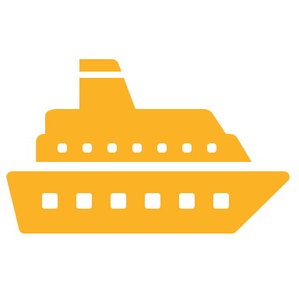
Operating costs
$188,000 the cost of delivering welfare services in 2022FY
1.3 FTE staff spanning welfare, operations and transport + numerous volunteers
Shore leave service alone is 50% of overall budget
Only 7% of our running costs were externally funded in 2022FY
4% from community donations and only 3% from the corporate sector

Slide 12
Cost of Shore Leave services
Indicative for 12 hours/day, 7 days/week
Maintenance Cost (2x services per year) | $2,000
Fuel | $3,000
Driver(s) incl. extras & loadings | $160,000
Insurance | $2,000
Tyres | $2,000
Replacement Reserve / Incidentals | $5,000
Registration | $1,000
 | $175,000
Funding will enable us to:
Pay a full-time or two part-time driver/shop assistants, which would allow us to:
Ensure all visiting ships have access to shore leave, transit services or deliveries to gangway
Release chaplain for more crew welfare and support
Keep retail shop prices affordable for seafarers
(Additional costs like centre maintenance, administration and site improvement projects not included in the above)

Slide 13
Funding Proposal

Slide 14
Our funding goal - $200,000
$120,000 |  | Which might consist of… 3 x $40,000/year funding partners
$40,000 |  | 2 x $20,000/year funding partners
$30,000 |  | 3 x $10,000/year funding partners
$10,000 |  | 5 x $2,000/year funding partners
This level of funding will enable us to:
Pay a full-time or two part-time driver/shop assistants, which would in turn allow us to:
Ensure all visiting ships have access to shore leave, transit services and ship visits
Deliver more welfare packs and Christmas bags
Keep shop pricing as low as possible
Funding will enable us to:
Pay a full-time or two part-time driver/shop assistants, which would allow us to:
Ensure all visiting ships have access to shore leave, transit services or deliveries to gangway
Release chaplain for more crew welfare and support
Keep retail shop prices affordable for seafarers

Slide 15
Benefits of funding partnerships
For corporate proponents:
Good corporate citizenship
Delivers ESG outcomes across your supply chain
Human rights
Mental and physical wellbeing
Fulfilling the obligations of the MLC
Public image (e.g. social media appreciation posts)
For seafarers and MTS:
Improved access to support
Increase our welfare provision
Sustainable delivery of services
Grow operations to meet increasing demand
Ability to plan and act strategically
Long-term viability of the centre

Slide 16
Will you help us, help seafarers?

Slide 17
Thank you for your support of seafarers, some of our most critical yet invisible workers
For more information please contact:
Rev. Peter Schendzielorz Chaplain & Executive Officer Mission to Seafarers Geraldton
info@geraldtonseafarers.org geraldtonseafarers.org

Slide 18
Centre overview and history
About the Mission to Seafarers
Mission to Seafarers Geraldton
Global Network
Operating for around 160 years
Looking out for the needs of seafarers
MTS Geraldton served seafarers since 1938.
Governed by the Missions to Seafarers North West Australia Ltd (MTS NWA)
MTS NWA is a not-for-profit public company limited
We care for seafarers of all ranks, nationalities and beliefs.
Notes:
The Mission to Seafarers is a global network, dedicated to advocating for seafarers around the world, offering support and practical assistance wherever we’re needed.
For over 160 years, the Mission to Seafarers has provided ship visiting services, Chaplaincy, access to onshore services and support.
With over 90% of the world’s goods and fuels transported by sea, so much of our prosperity depends on merchant shipping.
The men and women who keep this vital sector going need to know when they are out at sea and far away from home, that somebody is looking out for them. They need to feel seen, heard and understood.
Mission to Seafarers Geraldton has served seafarers visiting the Mid West region since 1938.
Based in the heart of Geraldton, we are governed by the Missions to Seafarers North West Australia Ltd (MTS NWA), an ACNC-registered not-for-profit charity set up as an agency of the Anglican Diocese of North West Australia.
MTS NWA is a not-for-profit public company limited by guarantee which is established to be, and to continue as, a charity. It enables stronger governance, buying power and administrative synergies across seafarers' centres in the North West of WA.
As an Anglican mission, we care for seafarers of all ranks, nationalities and beliefs.

